Slide 1
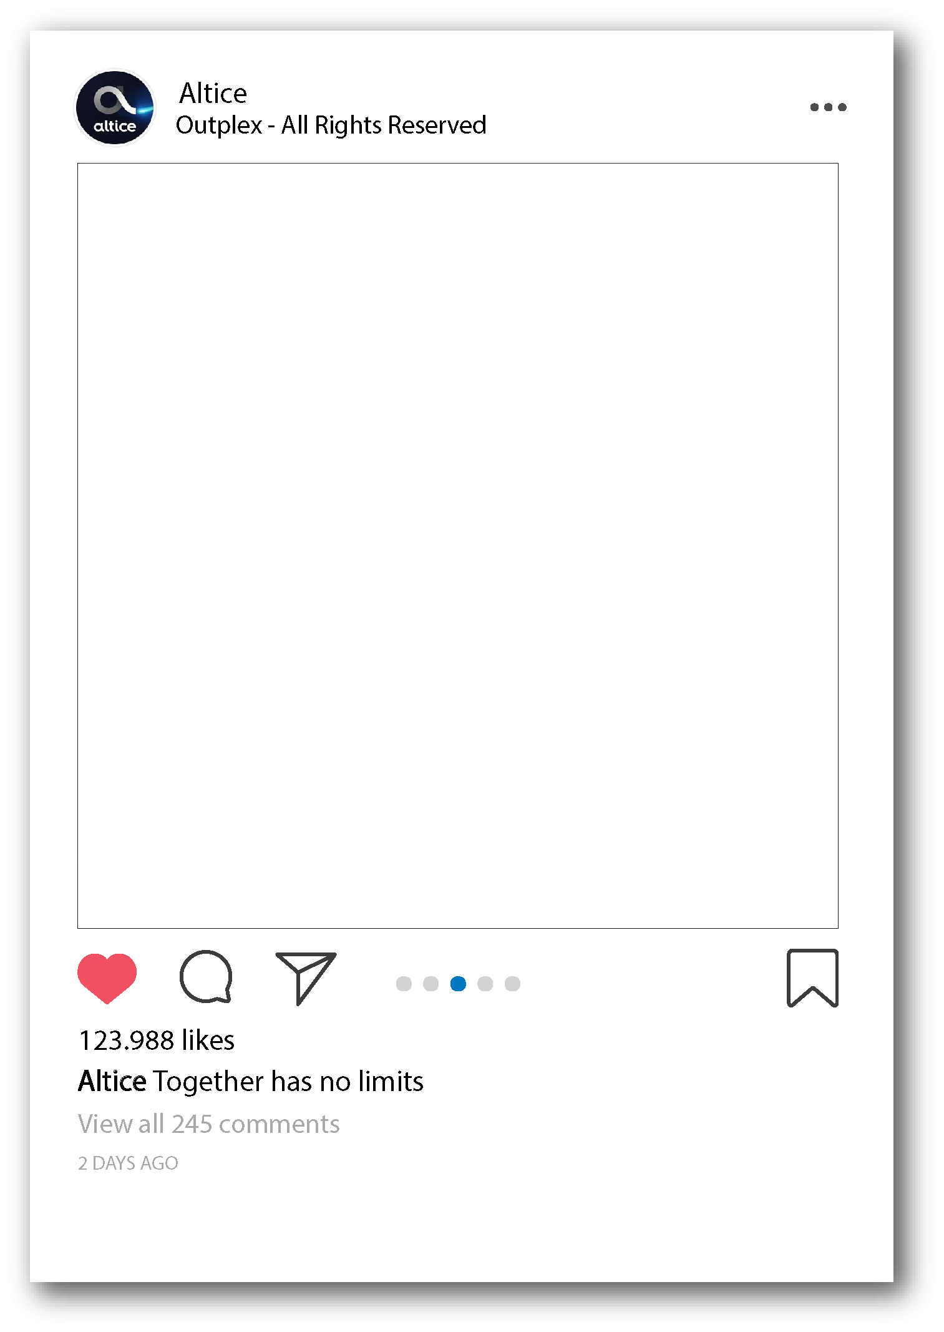
Suddenlink.net
Guide

Slide 2
How customers log in?
Customers have to click on “Sign in” on the Home screen of Suddenlink.net

Slide 3
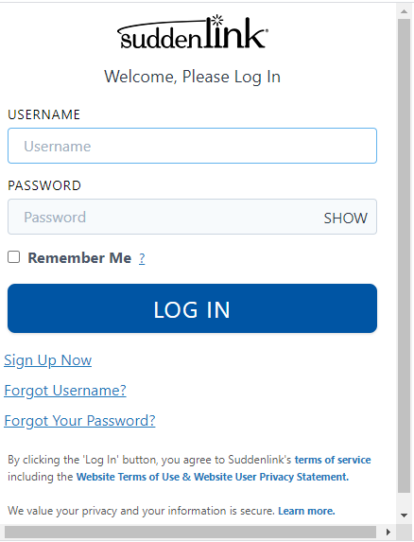
Customers then have to input their Suddenlink user and password in order to access their account.
If a customer has not yet sign up, the can also do so by clicking the “Sign Up Now” link

Slide 4
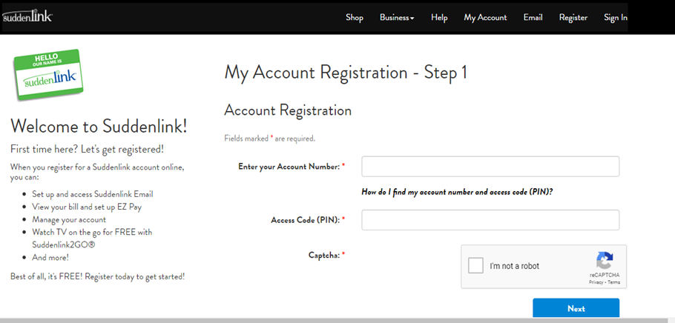
How can customers Register
By clicking on the “Sign Up Now” link customers can follow instructions to register.

Slide 5
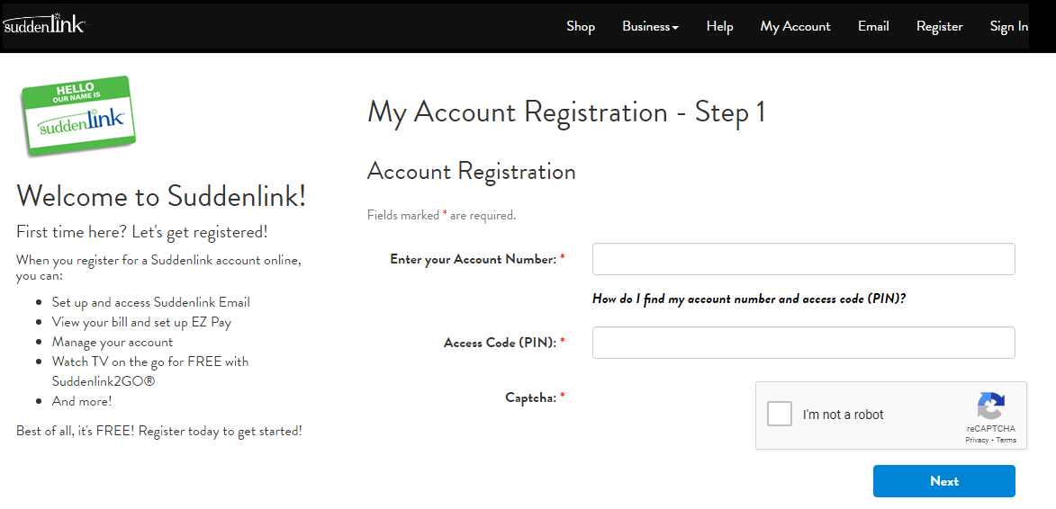
If customers do not know their account number or Access Code, ask them to click the following link.
This link will provide the customer a reference as to where they can get their Access code and Account Number (Their Bill).
To access, customers need acc. number and PIN.

Slide 6
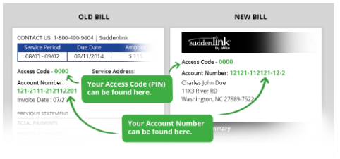
We can only pride account number and access code after the customer passes CPNI.

Slide 7
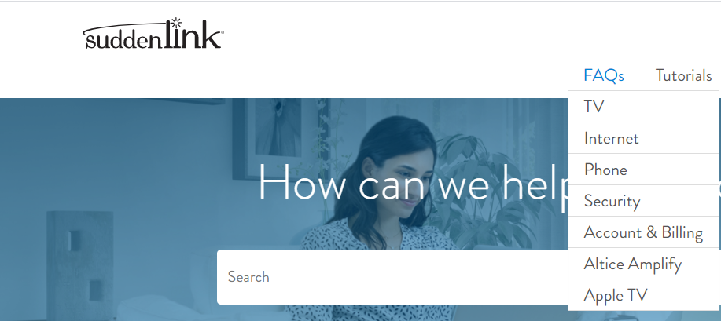
FAQs
Customers can also access the most frequent answers and questions in regards to TV, Internet, Phone, Security, Account & Billing, Altice Amplify and Apple TV. The following slides will show us what information contains each section.

Slide 8
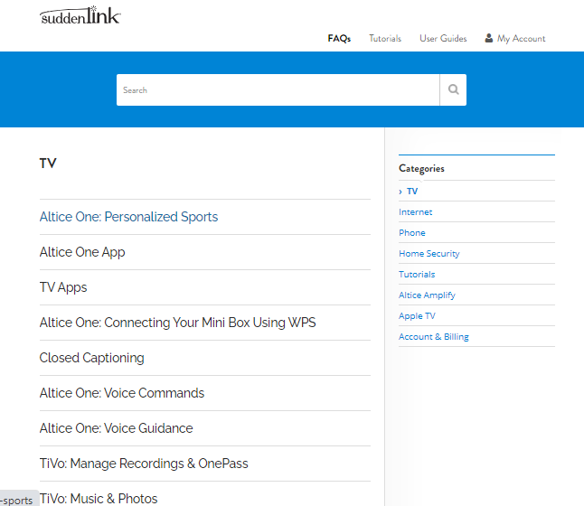
FAQs TV
As you can see in this section the customer has several topics within the FAQs – TV section

Slide 9
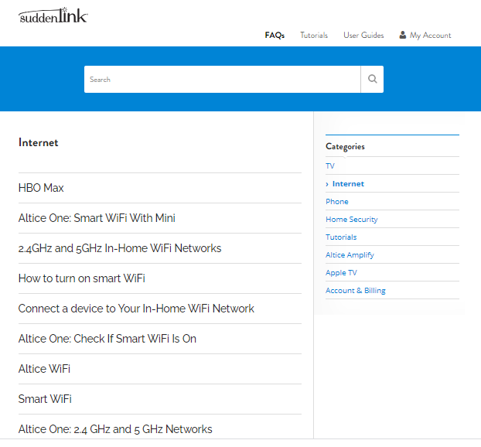
FAQs Internet
This section relays to Internet giving the customers several information related to this service.

Slide 10
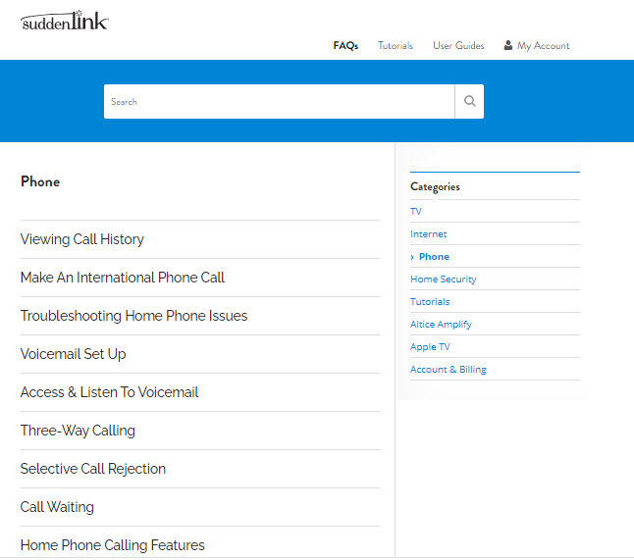
FAQs Phone
Section related to FAQs for our Phone product

Slide 11
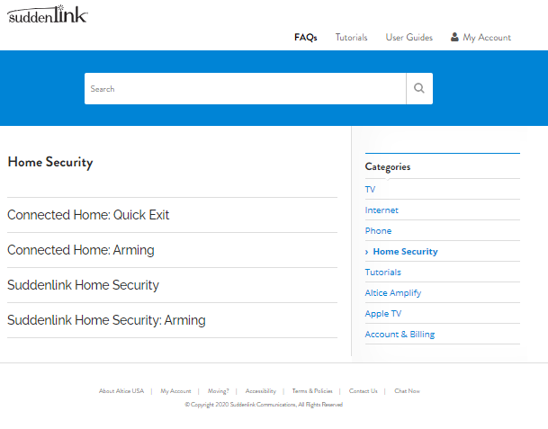
FAQs Security
Section where customers can find information on Home Security.

Slide 12
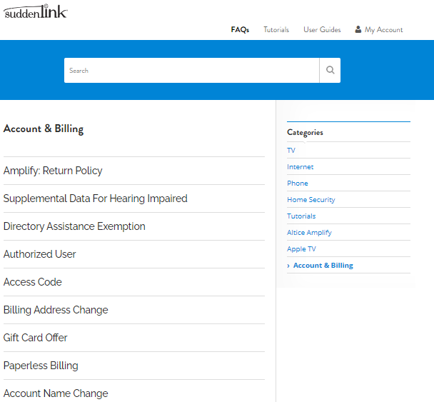
FAQs Account & Billing
Very important section. Customers have Information such as Authorized user, Paperless Billing, Account Name Change… etc.

Slide 13
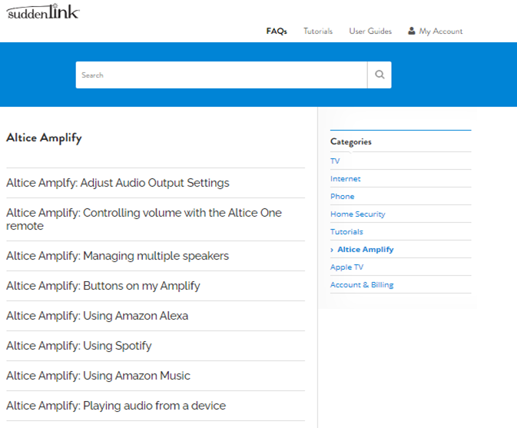
FAQs Altice Amplify
Customers also have Info on the Altice Amplify on this section, for example: Altice Amplify-Using Spotify.

Slide 14
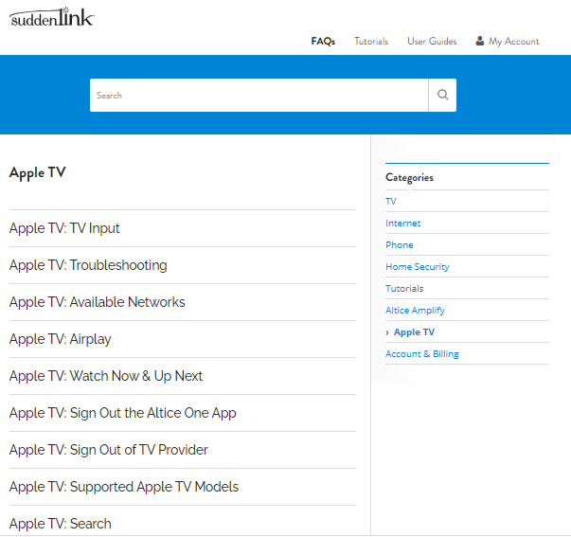
FAQs Apple TV
We also have a section to help our customers with Apple TV.

Slide 15
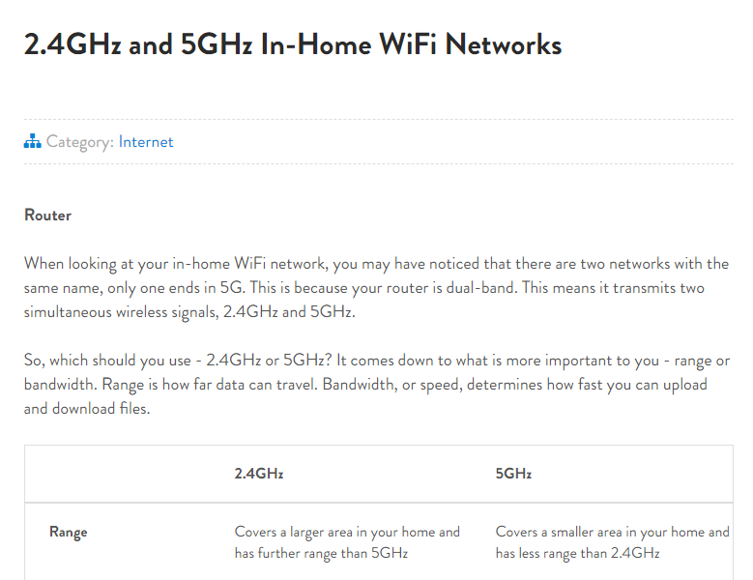

Slide 16
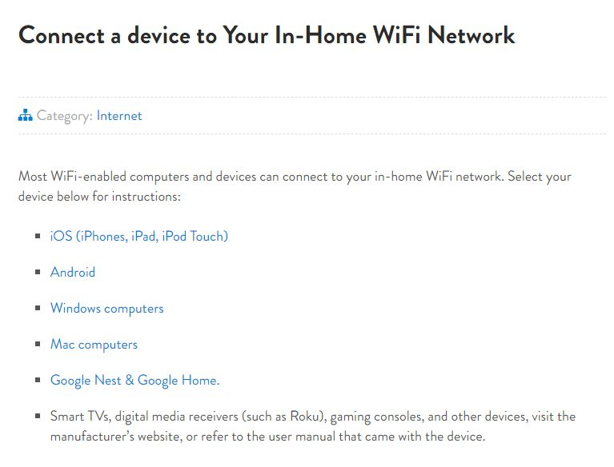

Slide 17
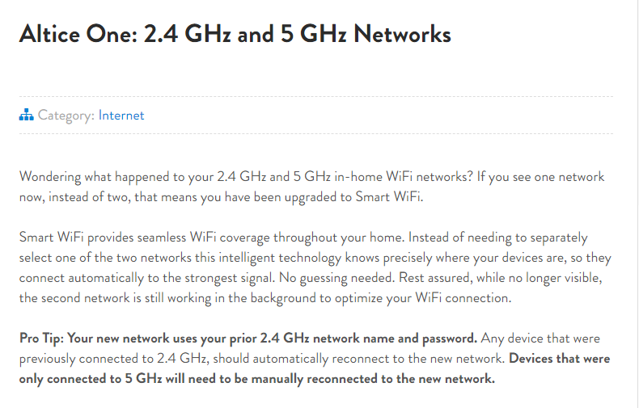
When the customer has problem to access internet on one of his devices, it is suggested that you change the Wi-Fi’s name with the correct Network (2.4 or 5 GHz).

Slide 18
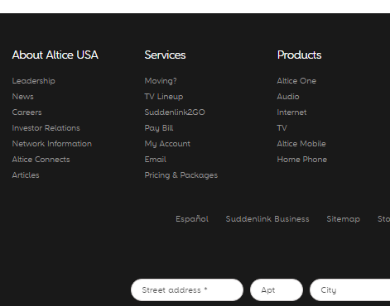
Customers can see channel lineup.
Pay their bill after logging into their account
See the packages and prices.

Slide 19
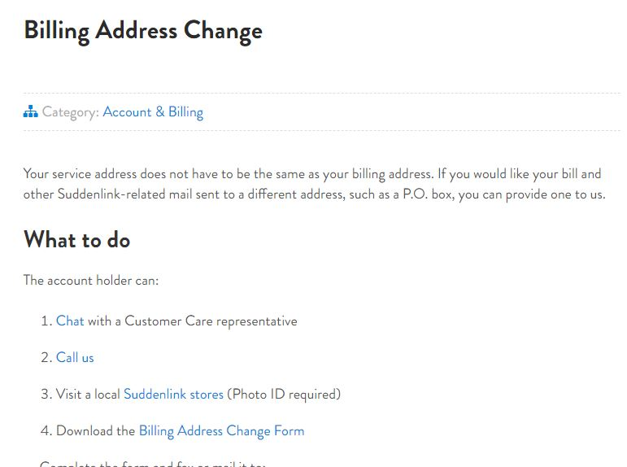
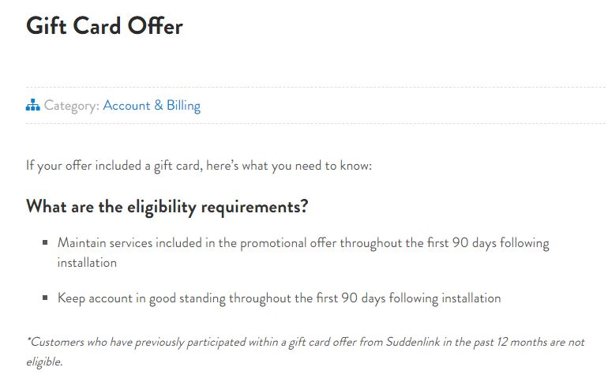

Slide 20
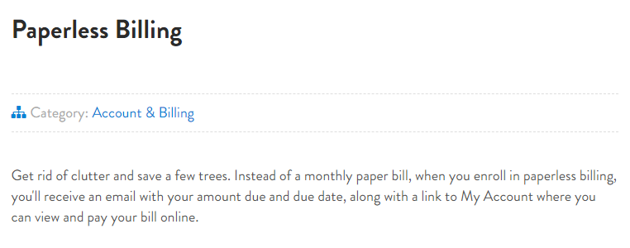
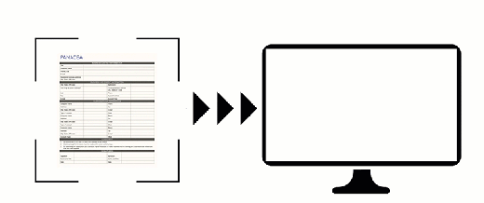

Slide 21
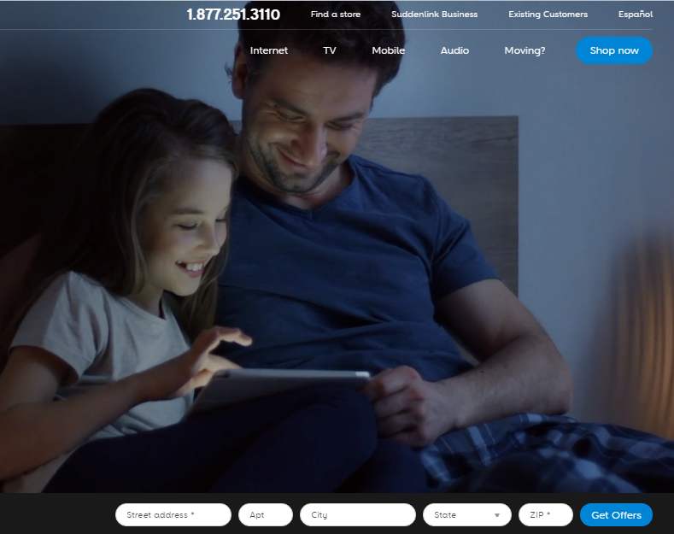
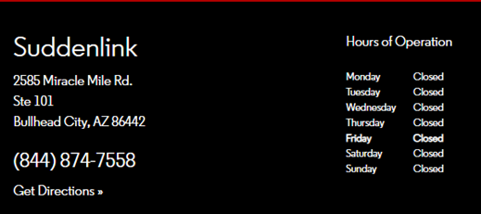
Get the address of every Suddenlink store, phone number and schedule.

Slide 22
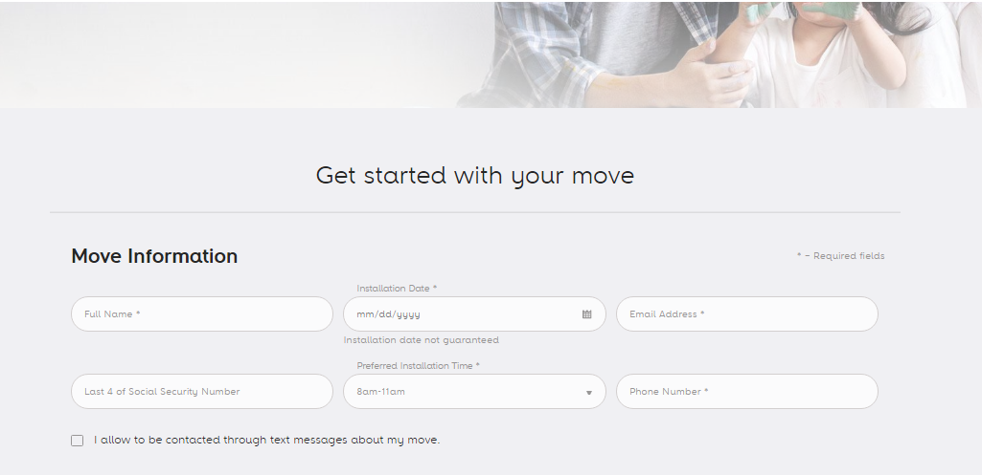
Order to transfer services to a different address.

Slide 23
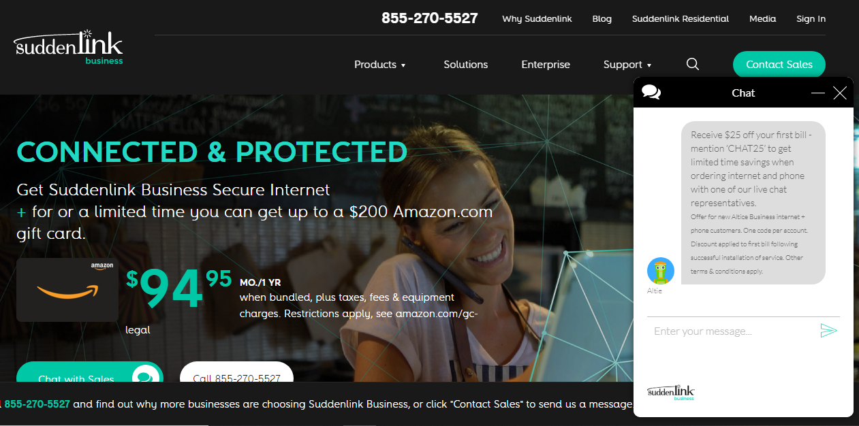
Access to Suddenlink business and chat with Altie.

